Slide 1

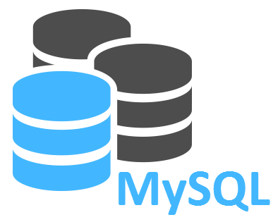


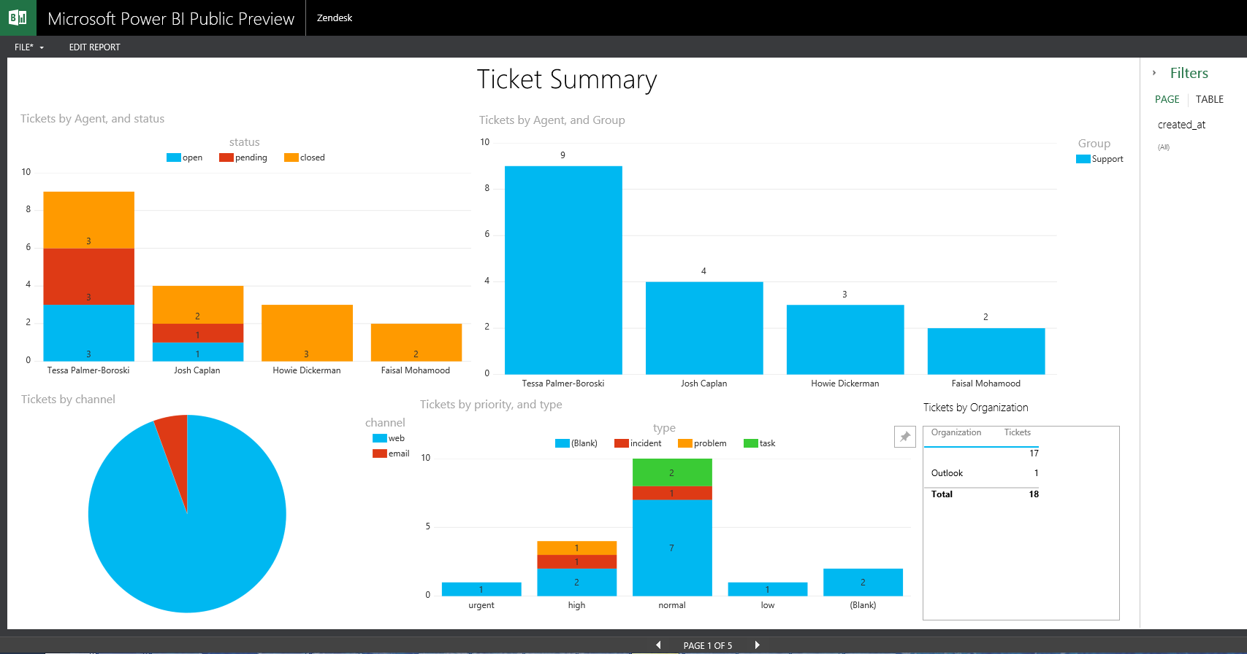
Central database
Automated data extraction
(redcapAPI)
Data extraction and processing
Processing.R
cronR Package
(task scheduler)
RStudio server
Server environment
Data export to Shiny app folders
Apps run within Shiny server
Shiny server
Web Dashboard
(output)
User 1
User 2
User 3
User 4
User...n

